Slide 1
Smartphone Security: Trends and Predictions
Dan Wallach, Rice University
Presented By:
Feras AL Tarouti

Slide 2
Introduction
Trend 1: smartphones are real computers.
Trend 2: many government, military, and private sector IT departments are locking personnel out of social network sites, pushing those users to do these activities on personal smartphones.
Trend 3: “Safe” web sites can and will be compromised.

Slide 3
Threat Models
High-value targets (HVT):
Worry about their phones being surreptitiously modified or even being stolen and replaced with replicas.
Low-value targets (LVT):
Hackers mostly interested in credit card numbers, banking passwords, and other ways they can make money.

Slide 4
SME-PED
Program aims to give U.S. military personnel a device analogous to civilian smartphones, yet also able to make top-secret phone calls and to interact at the secret level with the U.S. military’s classified network (SIPRNET) resources.

Slide 5
SME-PED
Has four distinct electronics boards:
A trusted crypto module.
Semi-trusted “black” and “red” compute modules.
Untrusted RF module (GSM or CDMA)

Slide 6
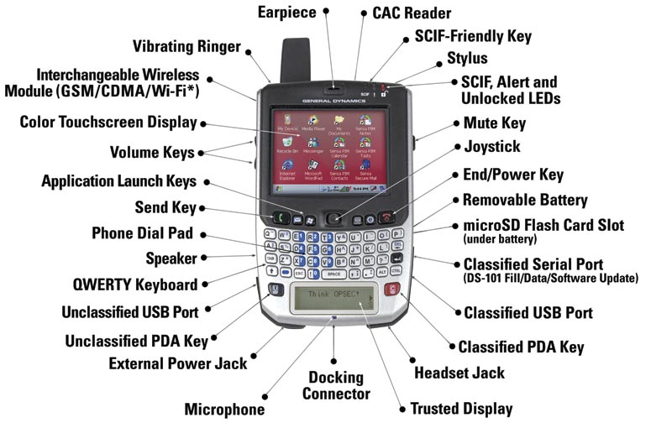
SME-PED

Slide 7
System-enforced policies
How can we impalement the previous semantics in normal smartphones?
Trusted path :
Dedicated Screen or area in SME-PED
Home button in iPhone
Control-Alt-Delete key sequence in Win NT

Slide 8
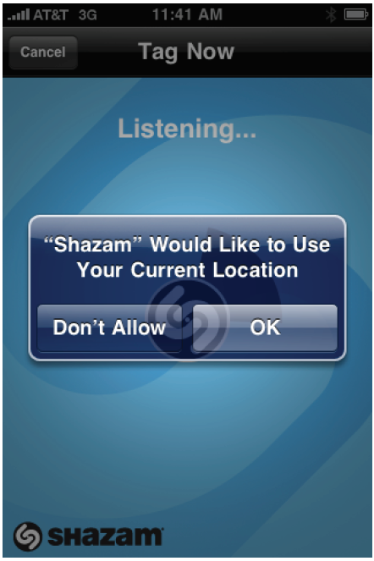
System-enforced policies
User-facing security policies
"Poorly engineered web browser warnings would be ignored by virtually all users (around 90%) while even the best-designed warnings would only be heeded by half of the users.“

Slide 9
Possible Solutions
Possible Solution: take these choices out of the hands of users
Will anger the user, he might disable the central administration.
Apple’s solution is a curious hybrid of enforcing a wide variety of rules in advance, prior to allowing apps into the iTunes Store, along with requiring apps to request permission for more invasive permissions at runtime.
it assumes that its app store policing function can prevent dangerous apps from ever reaching users.
it assumes that the apps that are present on the phone cannot be exploited.

Slide 10
Possible Solutions
Android leverages Linux’s own protection system, giving each app its own Linux user-id [1], and marking the protection bits in the filesystem such that users can neither see nor edit each others’ files. By treating each app as a distinct user, a security compromise in any one app is insufficient to take over the entire Android phone.
- What about shared resources (i.e. : address book) ?

Slide 11
Virtualization and forensics
Virtualization allows the Smartphone to save and restore its entire state to remote, trusted network services.
VMware is already working on such a technology.
Consider replicated execution on the phone and on a remote (trusted) server.
Example : Microsoft’s Ripley system

Slide 12
Ripley

Slide 13
Virtualization and forensics
We can implement software security mechanisms that parallel the hardware security separation techniques used in the SME-PED.
This may never be acceptable for secret level data or voice processing.
But it could be used to create a separation between users’ “work” uses of the phone and their “home” uses
Issues:
How to deal with shared resources like the address book?
How can we guarantee that a compromised VM cannot defeat the VM switching mechanism?
Can we use “trusted path” concept to solve them?

Slide 14
Attack surface analysis
In the HVT threat model, an attacker with physical access to a phone will ultimately be able to replace the code running on it.
In the LVT threat model, either a VM layer or a traditional operating system kernel running above it, need only be designed to resist external attacks, via hostile data transmitted over the network.

Slide 15
Attack surface analysis
software upgrades to the phone operating system
If we use docking connector :
PC-based malware could well be engineered to attack the Smartphone when it’s plugged in
A combination of strong digital signatures plus the use of the physical docking connector may be required in combination

Slide 16
Recommendations
Harden the users’ equipment
virtualization technologies to separate users’ personal and work computing spaces
Replacing old and insecure web browsers
Rather than banning Smartphones, use improved software architectures on these phones, they could be centrally managed, allowing professional systems administrators to do forensic analyses, detect attacks when they happen, and respond in a timely fashion.

Slide 17
Recommendations
A database with millions of Smartphone backups, all in one place.
Tools need to be developed that can distinguish between normal variances from one phone to the next and identify attacks without generating too many false alarms.
Human subject experiments

Slide 18
Questions

